Slide 1
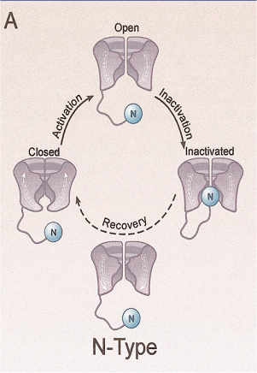
N-type channel inactivation or rapid inactivation: The “ball and chain” hypothesis (Armstrong y Bezanilla, 1977)
ShakerΔ6-46
Zagotta et al, Science (1990)
Inactivating “ball”: H₂N-MAAVAGLYGLEDRQHRKKQ
(Aldrich et al, Science 1991)
Notes:
The N-type inactivation of the potassium channel Shaker B consist on the occlusion of the cytoplasmic mouth of the channel by a cytoplasmic domain in the N-terminal of the protein (called the inactivating “ball” or ShB peptide). The channel Shaker B deleted in his inactivating ball is inactivated by a synthetic ShB peptide.
We wonted to know if KcsA (which is lacking the inactivating ball) could also be inactivated by the ShB peptide like in Shaker.

Slide 2
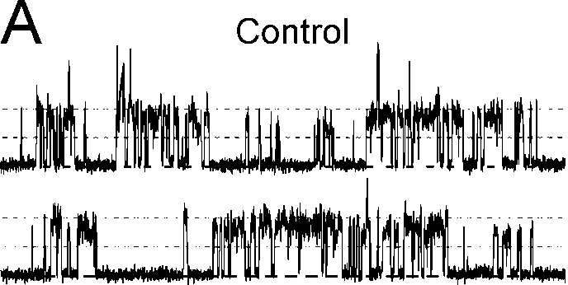
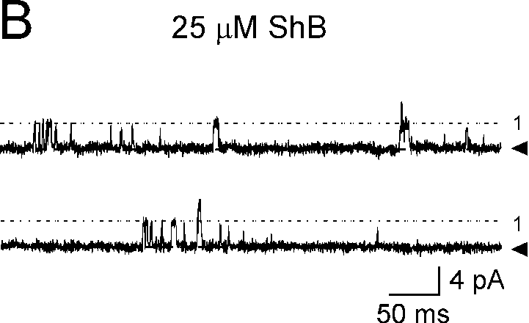
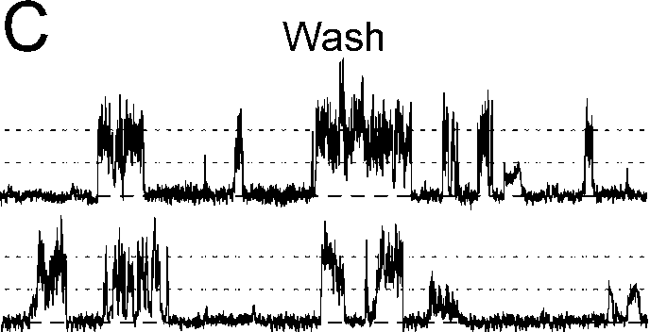
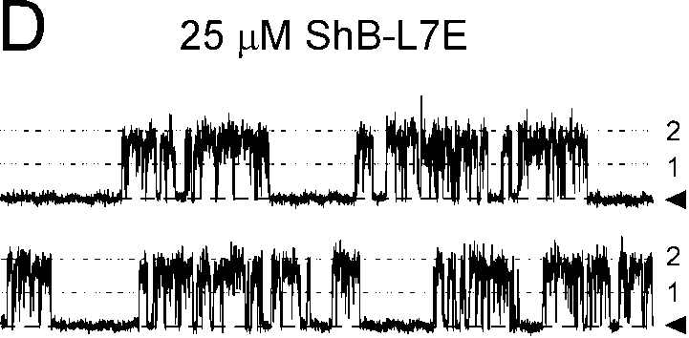
Modulation of KcsA, a prokaryotic channel by eukaryotic peptide ligands: The Shaker B peptide connection
+ShB
peptide
Inactivation of KcsA by ShB peptide was associated to the uncoupling of channels
Molina et al. J. Biol. Chem. (2008)
Notes:
We obtained that yes, when we added ShB peptide to the bath solution, we observed the inactivation of KcsA, and in addition, KcsA showed openings only of 4 pA, corresponding to uncoupled channels. So, the inactivation of KcsA by the ShB peptide was associated to the functional uncoupling of the channels.
The effect was reversible, and finally, a non-inactivating peptide of Shaker didn’t inactivate KcsA as we expected.

Slide 3
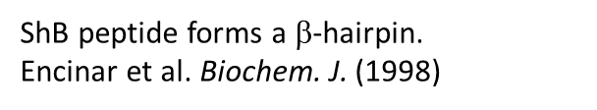
Anionic phospholipid vesicles as model targets for the inactivating peptide

Slide 4
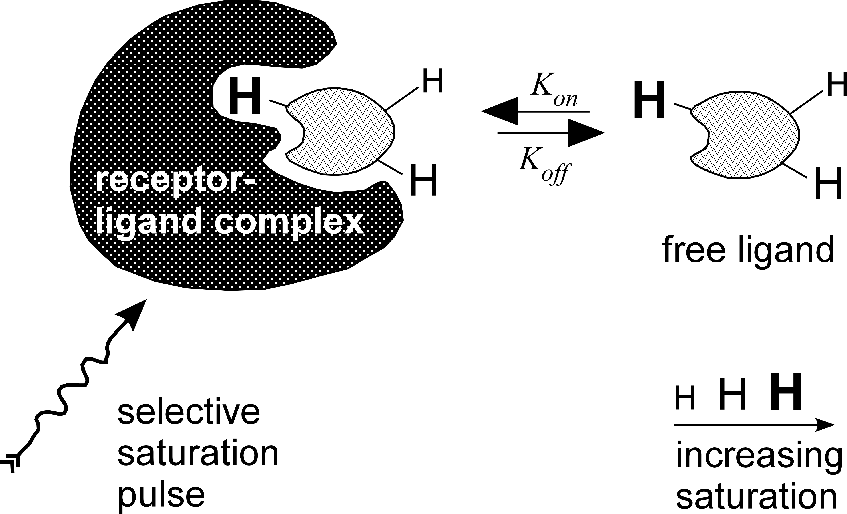
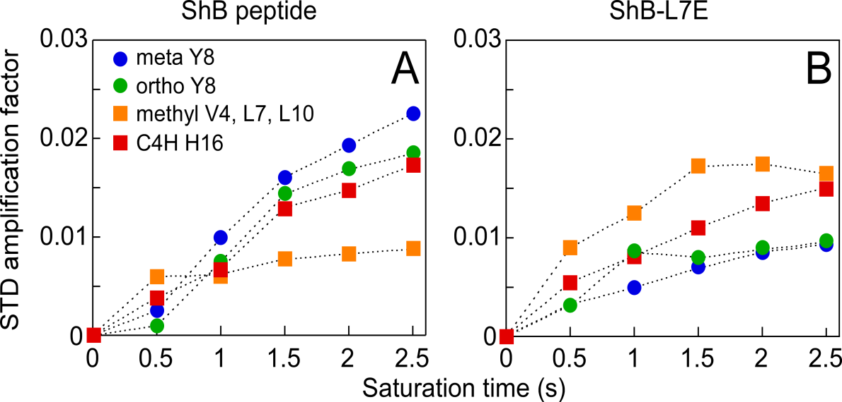
Evidence for the occurrence of the β-hairpin when the inactivating peptide is confronted to the KcsA channel:
STD-NMR: mapping of binding epitopes at atomic resolution
Group Epitope Mapping
for a Ligand in Fast Exchange
between the Bound and the Free State.
MAAVAGLYGLGEDRQHRKKQ
Notes:
We have also employed saturation transfer difference (STD) NMR methods to map the molecular interactions between the inactivating peptide and its channel target. The results indicate that binding of the ShB peptide to KcsA involves mainly Y8 and H16, and also aminoacids 4, 7 and 10.

Slide 5
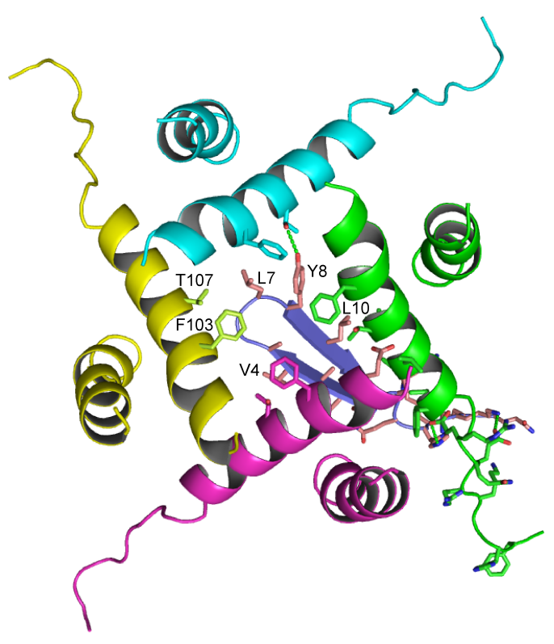
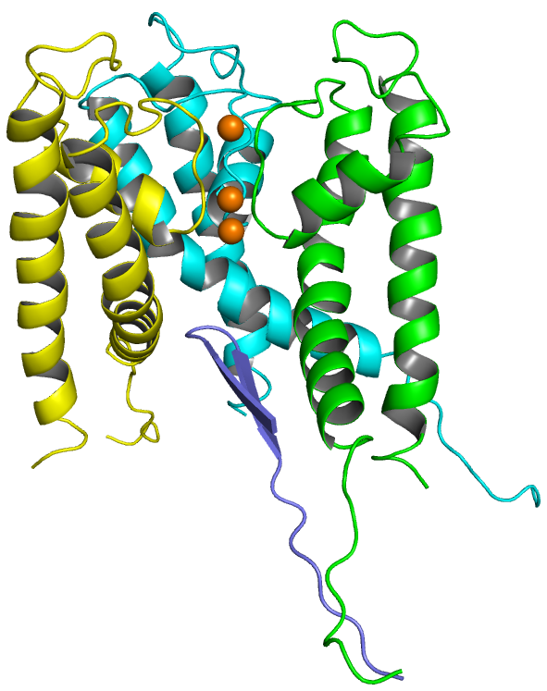
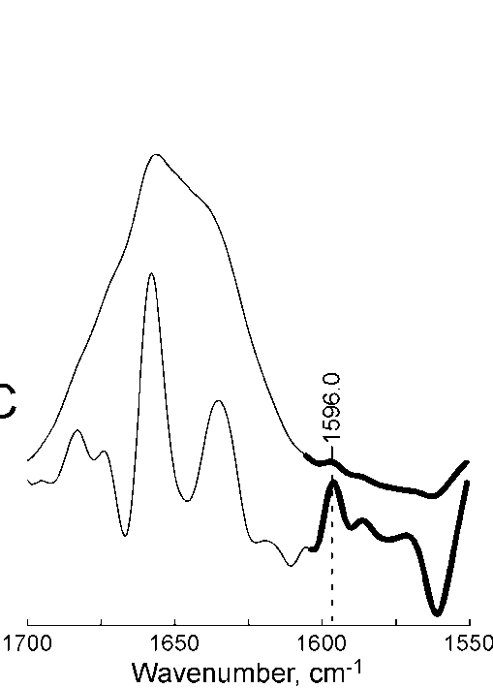
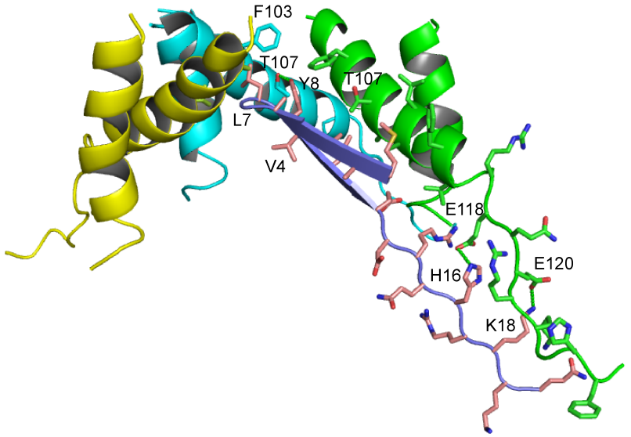
Evidence for the occurrence of the β-hairpin when the inactivating peptide is confronted with the KcsA channel:
Heavy-isotope FTIR and peptide docking
MAAVAGLYGLGEDRQHRKKQ
(1-¹³C derivatives in red)
KcsA(MthK)
ShB peptide + KcsA
¹³C-labeled
β- hairpin
ShB peptide
Molina et al. J. Biol. Chem. (2008)
Notes:
Additionally, Fourier-transform infrared spectroscopy of KcsA, in presence of 13C-labelled peptide derivatives, suggests that ShB peptide adopts a b-hairpin structure when bound to the KcsA channel. Indeed, docking such a b-hairpin structure into an open pore model for K channels to simulate the inactivating peptide/channel complex, predicts interaction well in agreement with the experimental observations.

